Slide 1
Microprocessor Systems and Interfacing CPE 342
Lecture 2- Week 4

Slide 2
PPI Applications
Outline
Mode 0 Operation :Interfacing Stepper Motor

Slide 3
Stepper Motor Interface
Stepper motor is digital in nature
It rotates in a sequence of discrete steps controlled by sequentially energizing a set of coils (windings)
Step angles vary from 1º to 15º depending on precision required (and cost)
ROL= Motor rotates anticlockwise
ROR= Motor rotates clockwise
0 | 0 | 1 | 1

Slide 6
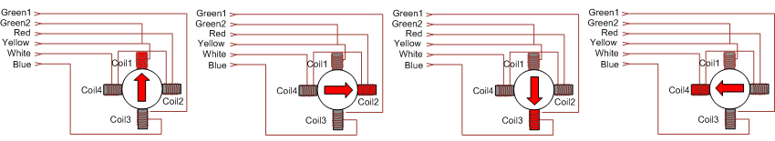
Stepper Motor
Wave Drive.
Signal sequence for Wave Drive Stepping Mode
Step | Yellow lead (End point 1 of Phase1) | Blue lead (End point 2 of Phase1) | Red lead (End point 1 of Phase2) | White lead (End point 2 of Phase2)
1 | 1 | 0 | 0 | 0
2 | 0 | 0 | 1 | 0
3 | 0 | 1 | 0 | 0
4 | 0 | 0 | 0 | 1

Slide 7
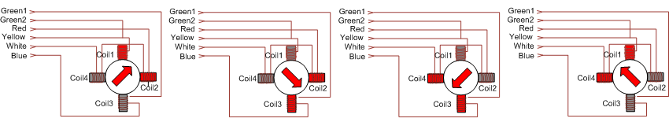
Stepper Motor
Full Drive.
Signal sequence for Full Drive Stepping Mode
Step | Yellow lead (End point 1 of Phase1) | Blue lead (End point 2 of Phase1) | Red lead (End point 1 of Phase2) | White lead (End point 2 of Phase2)
1 | 1 | 0 | 1 | 0
2 | 0 | 1 | 1 | 0
3 | 0 | 1 | 0 | 1
4 | 1 | 0 | 0 | 1

Slide 8
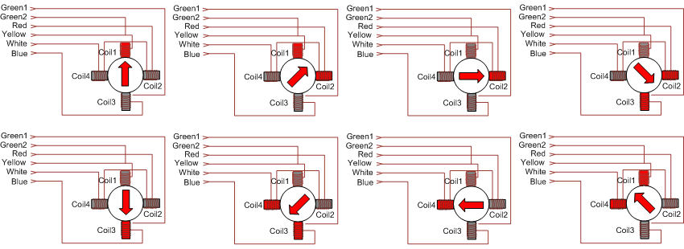
Stepper Motor
Half Drive.

Slide 9
Stepper Motor
Half Drive.
Signal sequence for Half Drive Stepping Mode
Step | Yellow lead (End point 1 of Phase1) | Blue lead (End point 2 of Phase1) | Red lead (End point 1 of Phase2) | White lead (End point 2 of Phase2)
1 | 1 | 0 | 0 | 0
2 | 1 | 0 | 1 | 0
3 | 0 | 0 | 1 | 0
4 | 0 | 1 | 1 | 0
5 | 0 | 1 | 0 | 0
6 | 0 | 1 | 0 | 1
7 | 0 | 0 | 0 | 1
8 | 1 | 0 | 0 | 1

Slide 10
Task
Modify the code to operate the stepper motor in half step mode.

